Slide 1
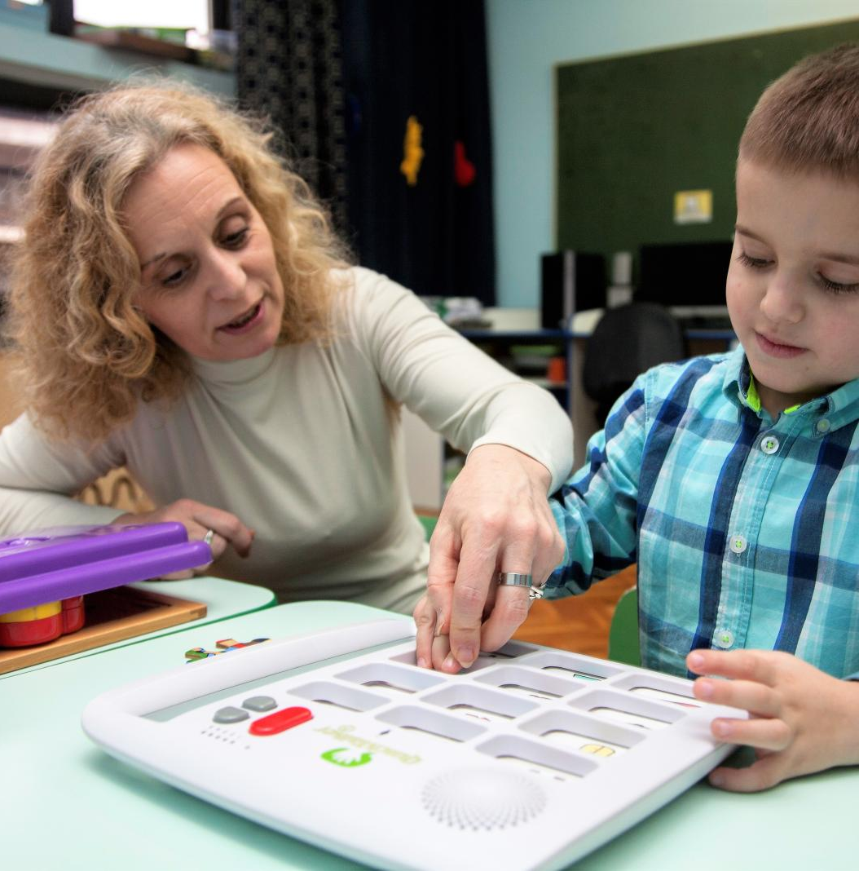
Assistive Technology
A description of the commonly used assistive technology devices and resources.

Slide 2
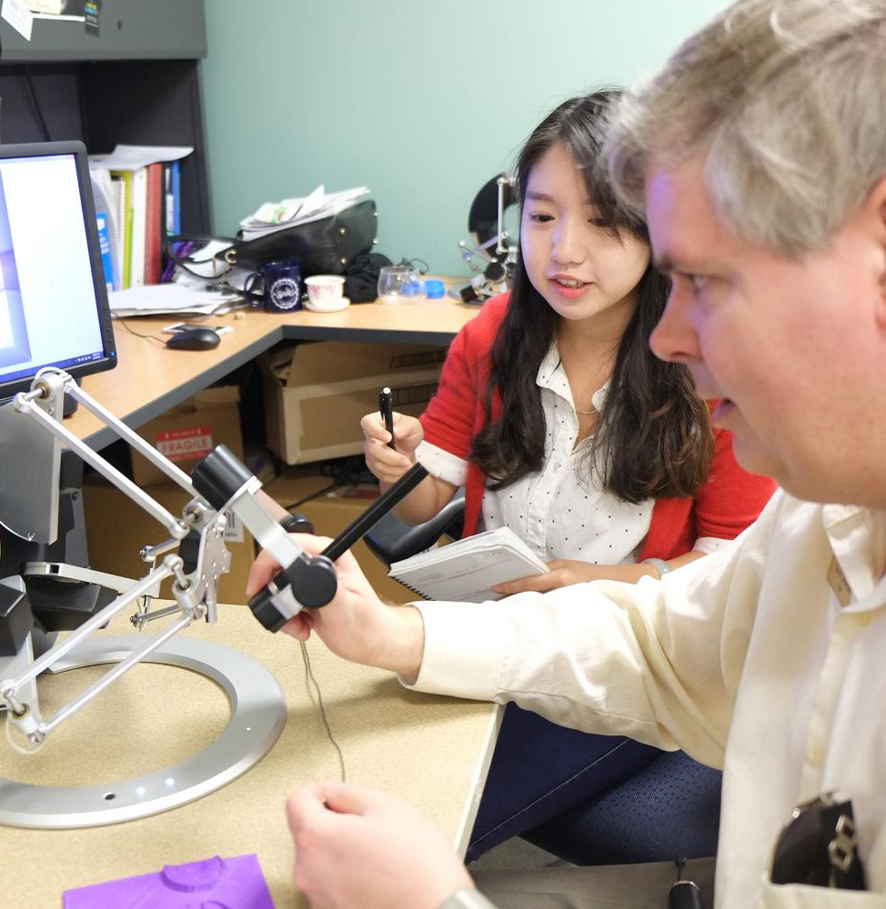
Introduction
Assistive technology are designed to make learning efficient for ASD students.
Technological advancement have improved of efficiency of AT.
Assistive technologies are grouped into three; low-tech, mid-tech, and high-tech.
Notes:
Assistive technology refers to devices, software, or equipment that helps with disabilities go around their problems, improve and maintain their functional capabilities in social and academic environments. As the number of special education students increases in American schools, technological innovations and advancements continue to offer better and improved ways of facilitating the teaching process (Ganz & Simpson, 2019). With time, assistive technologies have evolved from low tech to mid-tech, to the current high tech, making learning more efficient.

Slide 3
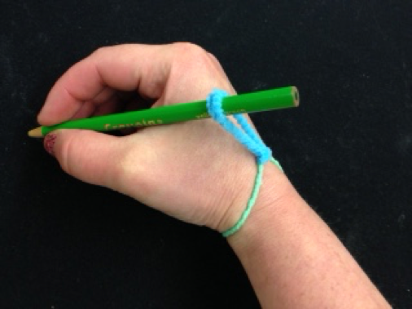
Low Tech AT
Basically traditional less complex assistive technologies. They include;
Graphic organizer is used to help students organize their thoughts before answering.
Visual Schedules which use pictures to teach sequence of events.
Pencil Grip provides a comfortable grip for holding writing materials.
Highlighter contours reading material.
Notes:
Low tech assistive technology refers to devices and resources that are less expensive, does not require much training to operate, and do not comprise of complex electrical or mechanical systems (Daud et al., 2018). One such resource is the Graphic organizer, which helps students organize their thoughts before answering questions by providing them with writing tools where they can record their thoughts and ideas. Another resource is the Visual Schedules which uses pictures to illustrate a series of activities and procedures to be followed. Visual Schedules help children with autism disorder spectrum manage their daily activities and understand the procedures of doing things on their own. The third resource is Pencil Grip which provides a better grip to writing materials, including pencils, by providing a comfortable grip and avoiding fatigue. The fourth resource is the Highlighter, which is used to create contouring on educational material, brightening the areas on which the student should focus (Daud et al., 2018).

Slide 4
Low Tech AT (Cont.)
Velcro fasteners replace laces and buttons and help fasten clothes and shoes.
Manipulatives provide tangible feel to facilitate 3D learning.
Tactile ruler improves participation of visually-impaired students.
Squishy ball helps improve focus and concentration.
Post-it’s helps cognitive impaired students improve on remembrance skills.
Binder clip helps keep papers and documents together.
Notes:
Additionally, low tech AT also includes Velcro fasteners, which are used in place of buttons and laces to help keep clothes and shoes on, especially for children with ASD, who cannot do it by themselves (Daud et al., 2018). The other resources are Manipulatives, which are generally tools that facilitate the process of learning the abstract academic concepts by providing a tangible feel of 3D objects. The other resource is tactile ruler, which is a ruler designed with four times finer features to provide more precision. The ruler helps visually-impaired students participate more actively in class. Another device is the squishy ball or sensory input (fidgets), which is an automatic tool that helps students improve on their focus and concentration by keeping their fingers occupied. Post-it’s is also an essential low tech device where ASD students can write short notes and reminders of things to do later (Daud et al., 2018). The post it’s is basically a which a small piece of paper that has glue on of its sides. Finally, we have the binder clip which is a simple device that is used to keep pieces of paper together to avoid loss, while also making it easier to retrieve them at any time.

Slide 5
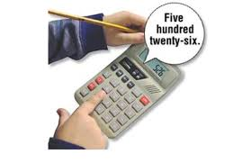
Mid-Tech AT
More sophisticate technologies that require some training to operate. They include;
Gait trainer, which facilitates movement.
Calculator, which conducts arithmetic operations.
Braille Translation Software which translates electronic documents into braille.
Notes:
Mid-tech assistive technologies, which form the second category, are typically more advanced than low tech AT, meaning that they are more sophisticated, require some level of training, and are more expensive. Most are battery-powered and are considered a low form of technology. With advanced technology, mid-tech AT are quickly being faced off (Daud et al., 2018). The first device that falls under this category is the gait trainer, which is basically a wheeled device that enables individuals with physical disabilities to independently walk as part of their gait training. Another device is the calculator, which is a device that is used to perform arithmetic operations using numbers. Thirdly we have the Braille Translation Software which is a computer software whose main role is translating electronic documents into braille code, which is easier for blind students to read.

Slide 6
Mid-Tech AT (Cont.)
Wheelchair a manually propelled used for movement.
Audiobook which helps improve the learning pace for ASD students.
Adapted keyboard which is used to input information into systems.
Word prediction software that helps in getting the right spelling.
Adapted seated system which helps students maintain an upright position while undertaking activities .
Adapted switches help with operating devices remotely.
Screen magnifier increases the size of objects displayed on screens.
Notes:
Additional devices include the wheelchair which is a wheeled mobility device that is manually propelled and is used for moving from one point to another. Physically disabled individuals use them. Another resource is the audiobook, which is basically an audio recording of a book or any other piece that helps individuals with cognitive disabilities learn faster and efficiently (Daud et al., 2018). The adapted keyboard, on the other hand, is a commercialized custom-made keyboard that includes modifications like easy-to-read labels, bright colours, and various layouts, that makes it easy for special needs students to use it. Furthermore, the word prediction software is a computer software that helps individuals identify and the right spelling for words (Daud et al., 2018). Another device is the adapted seated system which is designed to give special needs children support to their back and improve mobility while the child engages in other activities. Furthermore, we have the Adapted switches are access devices designed to help individuals with physical disabilities operate electronic devices. Finally, we have the Screen magnifier, which is a software whose main role is increasing the size of items displayed on screens (Boutot, 2017).

Slide 7
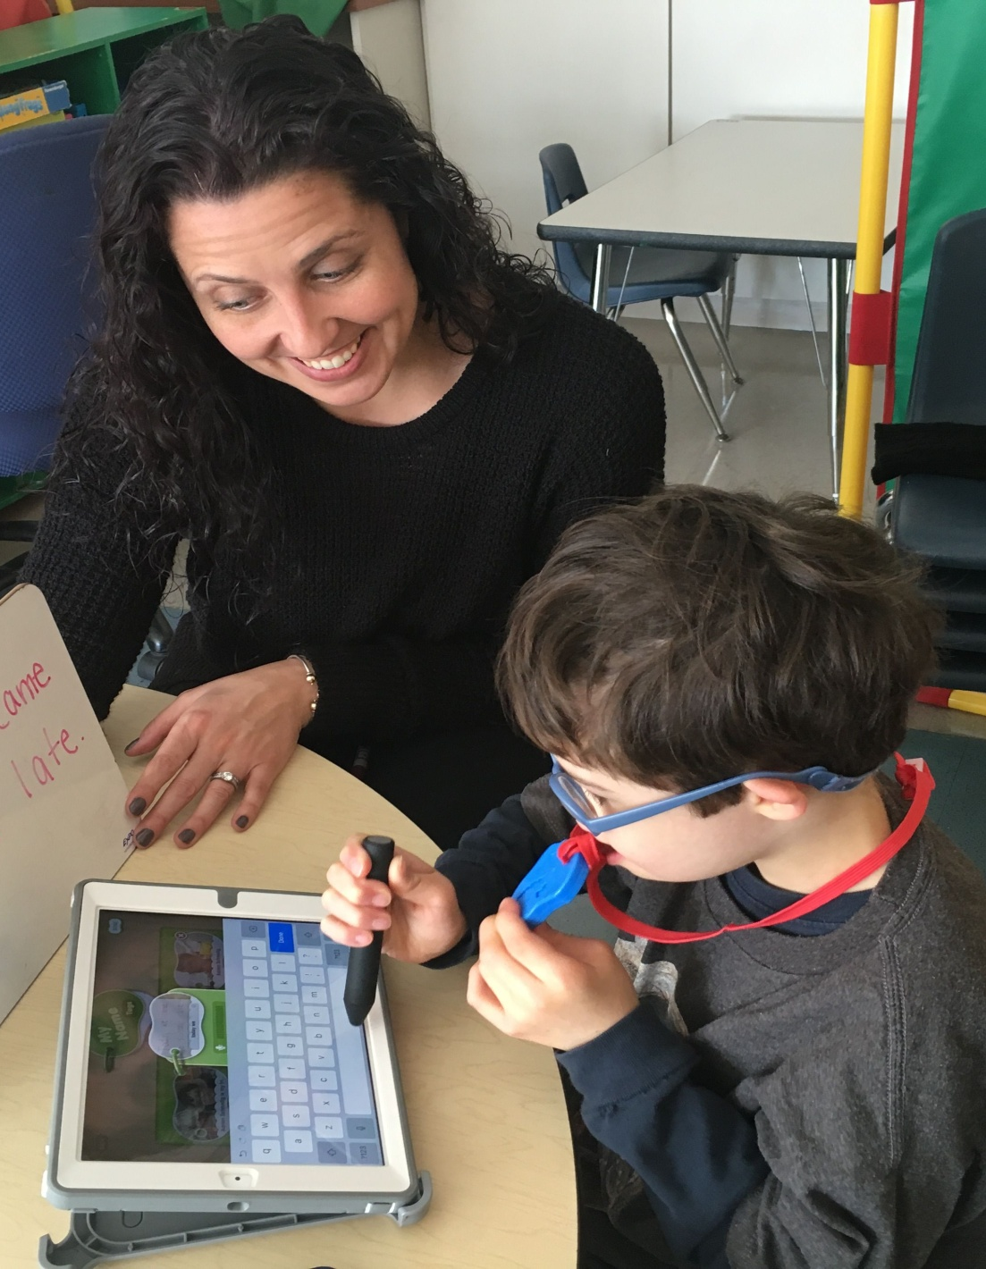
High Tech AT
Most sophisticate set of equipment and devices.
Contain electronic components and are highly computerized. They include;
Text to speech assistive tools used for improving reading skills.
Electric wheelchair which facilitates movement.
Draft Builder used to maintain concentration while writing.
Proofreading software which help check on grammar.
Notes:
The third category of assistive technology, the High-Tech Assistive Technology Devices/Resources refers to the most complex and sophisticated devices and equipment that comprise of digital and electronic components and are highly computerized. High-tech devices are referred to as ‘plugin’ due to their improved efficiency (Daud et al., 2018). The first resource is the text-to-speech assistive tool which comprises of computer software that help children with disabilities like dyslexia in reading written print. The second device is the electric wheelchair, whose main purpose is to help physically disabled individuals move from one point to the other. The electric wheelchair performs similar functions as the regular wheelchair, though the main difference is that the former is electrically propelled. The third resource is the draft builder, which is a writing tool that helps children who cannot maintain concentration. The tool collects inputs from the student and integrates it into a well-organized rough draft (Daud et al., 2018). Fourth we have the proofreading software. These are software that helps students identify and rectify problems in academic compositions. Students with dyslexia use this software more since they have reading and writing problems.

Slide 8
High Tech AT (Cont.)
Assistive listening devices which help improve the listening skills.
Speech-generating devices which transform text into voice output.
Alerting device which help warn the blind students of any impending danger.
Smartboard which provides a user-friendly whiteboard for operating computers.
Math simulation helps students better understand basic mathematics concepts.
A computer which helps students perform various activities independently.
Notes:
Additional devices include assistive listening devices whose main aim it to help students with hearing disabilities by capturing and bringing sound waves close to the student’s ears. For speech-generating devices, they are electronic augmentative and alternative communication (AAC) systems that help with voice output, enabling verbal communication. Additionally, Alerting device help blind students maneuver by giving them alert signals in the form of sound or vibration in case of any threats or dangers (Daud et al., 2018). Another device is the Smartboard, whose main aim is to provide an interactive whiteboard that facilitates the operation of computers by touching the screen. Additionally, we have the math simulation software, which is commonly used by students with dyscalculia to improve on their mathematical conceptualization. Math simulation software present basic mathematical concepts through visualization. Finally, we have the computer, which is the most common high-tech device. The computer helps ASD students by providing a user-friendly interface that enhances the ability of students to handle a wide range of activities independently (Daud et al., 2018).

Slide 9
References
Boutot, A.E. (2017). Autism Spectrum Disorders. Boston: Pearson
Daud, S. N. S. C., Maria, M., Shahbodin, F., & Ahmad, I. (2018). Assistive technology for autism spectrum disorder: a review of literature.
Ganz, J. B., & Simpson, R. L. (2019). Interventions for Individuals with Autism Spectrum Disorder and Complex Communication Needs. Augmentative and Alternative Communication Series. Brookes Publishing Company.

